Slide 1
Search in open reading frame in DNA

Slide 2
Introduction
An open reading frame is a portion of a DNA molecule that, when translated into amino acids, contains no stop codons. The genetic code reads DNA sequences in groups of three base pairs, which means that a double-stranded DNA molecule can read in any of six possible reading frames--three in the forward direction and three in the reverse. A long open reading frame is likely part of a gene.

Slide 3
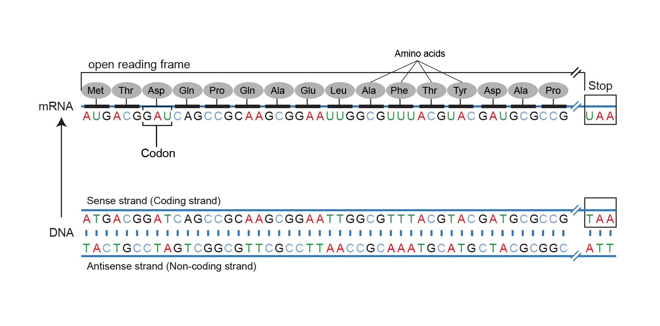
Introduction
An open reading frame is a portion of a DNA molecule that, when translated into amino acids, contains no stop codons. The genetic code reads DNA sequences in groups of three base pairs, which means that a double-stranded DNA molecule can read in any of six possible reading frames--three in the forward direction and three in the reverse. A long open reading frame is likely part of a gene.

Slide 4
What is the meaning of it
Open reading frame" is a terrible term that we're stuck with. What it refers to is a frame of reference, and what is being read, "reading", is the RNA code, and it is being read by the ribosomes in order to make a protein. Using Awesome Backgrounds

Slide 5
And "open" means that the road is open to keep reading, and the ribosome will be able to keep reading the RNA code and add another amino acid one after another. Now, DNA, though it is a monotonous repetition of As, Cs, Ts, and Gs, has a language, which is transcribed, of course, into RNA and then translated into a protein.
And when it's translated into a protein, the mRNA is not read one letter at a time, but it's read three letters at a time. And those three letters are called a codon, and each of those codons, whether it's an AAA or UUU or an AUG, each of those codons is interpreted by the ribosome, the molecular machine, that's going to make the protein as a certain amino acid

Slide 6
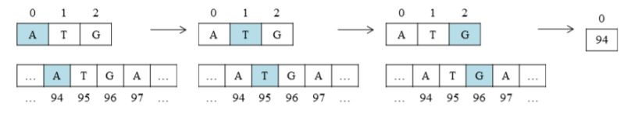
the sequence data of seq and given a variable a value of 0, b has an initial value equal to the index j value of 0. Next conditioning is done if the contents of the index seq [b] = start codon [a] then the next coding will be done with the values of a and b increase by 1 and j = 0, as in Figure. If all three conditions are met at a given value j, then each start codon found in the index number seq will be stored in the list
The function of this append is to add items to the new list from behind. The index number found is then recognized as the start position of the codon

Slide 7
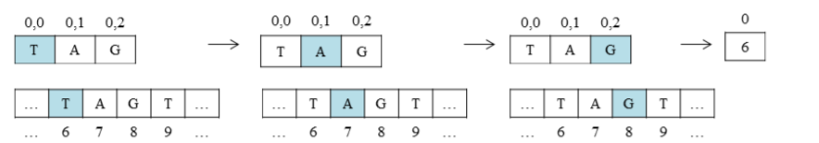
Stop codon is marked with "TAG", "TGA", and "TAA". Then multi-dimensional lists are used to have the list concept in the list. To process a 2-dimensional list, it is necessary to use nesting loops. The process of working on the stop codon search is similar to startcodon search if seen in Figure 5 but there are conditions that use 2 dimensions in this process.

Slide 8
What is project Idea
The longer an open reading frame is, the longer you get before you get to a stop codon, the more likely it is to be part of a gene which is coding for a protein. Now the finally confusing thing about an open reading frame is that because the codons are three nucleic acids long and DNA has two strands, the ribosome can read an RNA derived from one strand or another, and it can read it in 1-2-3s that are separated one from another so you can actually get three reading frames reading in one direction, three reading frames going in the other direction. So it's actually six different reading frames for every piece of DNA, which might give you an open reading frame.

Slide 9
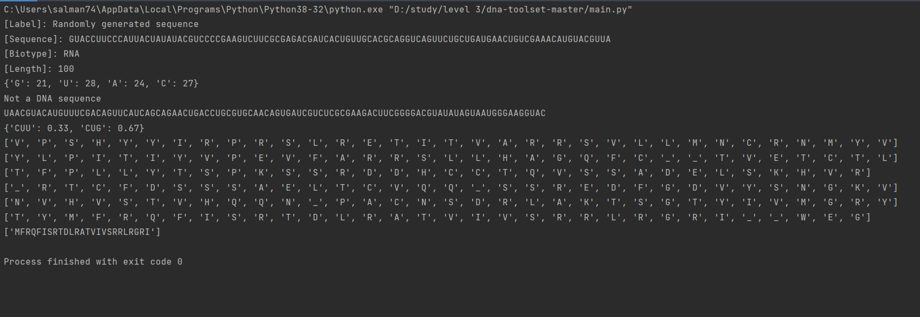
Discussion and Result
The stage in this study begins with the process of inputting DNA sequence data and codons, which then search for codon start and stop codon
First we make a random function to make us a random NUCLEOTIDE_BASE

Slide 10
Discussion and Result
3rd calculate the frequency of the sequence

Slide 11
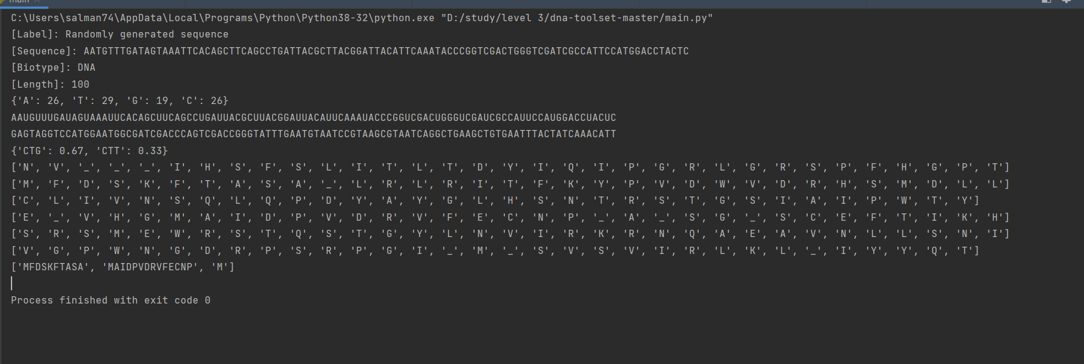
Discussion and Result
4th transcription if the sequence was DNA
5th we do a reverse_complement function to prepare the seq for Generating the six reading frames of a DNA sequence, including reverse complement

Slide 12
Discussion and Result
6th compute all possible proteins for all open reading frames
Which start codon is mentioned by (m) letter and stope
codon is mentioned by (_) from DNA_Codons and RNA_Codons dicetonary

Slide 13
Conclusion
Solving search problems into the start and stop codon position search stages which are stored in the new list and then processed again when determining ORF. In addition, the start codon index is smaller than the stop codon index in order to form each ORF series and find out the length of each ORF by reducing the index value of daftar stop with a daftar start

Slide 14
References
Neil A. Campbell and Jane Reece, Campbell Biology 11th Edition. New York: Pearson Higher Education, 2003.
Nature.com. nature.com. [Online]. https://www.nature.com/subjects/open-reading-frames Accessed on November 16, 2018
ncbi.com. NCBI. [Online]. https://www.ncbi.nlm.nih.gov/nuccore/NC_001477 Accessed on Oktober, 2018
https://gitlab.com/RebelCoder/dna-toolset

Slide 15
Team member
Name | Work
Mostafa Ahmed Saied | Code Searching and Presenting
Khaled Mohamed Ali | Code Searching and coding.
Ahmed Sapry Salman | Coding and Presentation making.
Norhan Taha Shawky | Code Searching and Coding.
Salma Ahmed Hassan | Protein Sequence Searching.
Hagar Waleed Shoieb | Searching and making presentation.

